Slide 1
IBM University Engagement Project Submission
“Exploring the Power of Agentic AI with IBM Granite and IBM Bob”

Slide 2

Project Tile – [RAG Agent for Recipe Generator]
Domain of Project – [ Artificial Intelligence(AI) ]
Student Name | Recent Passport Photo | Email ID | Mobile number [WhatsApp]
Arushi Jaiswal |  | arushijaiswal2812@gmail.com | 9696229047
Recommended font style and size: Font Style: Arial Font Size (Heading): 28
Font Size (Content): 20

Slide 3
Problem Statement -
Problem Statement No.8: Document Q&A RAG Agent for Recipe Generator
The Challenge
Food enthusiasts and culinary professionals often rely on unstructured recipe documents, cookbooks, blogs, and user-submitted notes. Searching across these scattered resources is time consuming, and it’s difficult to adapt recipes based on dietary needs, available ingredients, or cultural preferences. The challenge is not just to retrieve recipes but to intelligently query, adapt, and generate personalized cooking instructions.
The Objective
Build a Document Q&A RAG (Retrieval-Augmented Generation) Agent that can act as an intelligent recipe generator. The solution should:
Ingest & Index Recipe Documents: Parse cookbooks, PDFs, blogs, or uploaded recipe notes and store them in a searchable knowledge base.
Enable Conversational Q&A: Allow users to ask natural language questions (e.g., “How can I make a sugar-free version of chocolate cake?”) and receive precise, recipe-aware answers
Create a Personalized & Agentic Layer: Adapt recipes based on user constraints such as available ingredients, dietary restrictions, cooking time, or cuisine preferences.
Visualize Cooking Guidance: Present results as step-by-step cooking instructions with substitution suggestions, nutritional facts, and even generate a shopping list.
Tech Stack (Mandatory)
IBM Langflow / IBM Orchestrate + IBM Models

Slide 4
Proposed Solution -
Proposed Solution: AI-Powered Recipe Generator
The proposed solution is a multi-agent AI-powered Recipe Agent built using IBM Bob, and Granite Models to provide personalized, real-time recipes guidance.
At its core, the solution uses a Retrieval-Augmented Generation (RAG) pipeline to fetch accurate nutritional data from trusted sources such as USDA and WHO datasets. This data is embedded and stored in a vector database, enabling the system to retrieve and summarize food recipes using Granite models.
We propose an AI-powered Recipe Generator that helps users find and create recipes based on their preferences and available ingredients:
Uses AI to generate personalized recipes.
Provides filters such as Vegetarian, Vegan, Breakfast, Dessert, Seafood, Indian, and Quick.
Allows users to search recipes easily.
Generates ingredients and step-by-step cooking instructions.
Offers a simple and user-friendly web interface.
IBM Bob is used to orchestrate agent workflows, while Granite models power reasoning, summarization, and personalization.
Overall, this solution delivers an end-to-end intelligent recipe assistant that provides quick and convenient recipe suggestions according to user requirements.

Slide 5
Technology Used
IBM Bob platform -For designing and orchestrating multi-agent workflows visually
IBM Grainte model - for eg – ibm-granite-3-2-8b – For natural language understanding, reasoning, and personalization

Slide 6
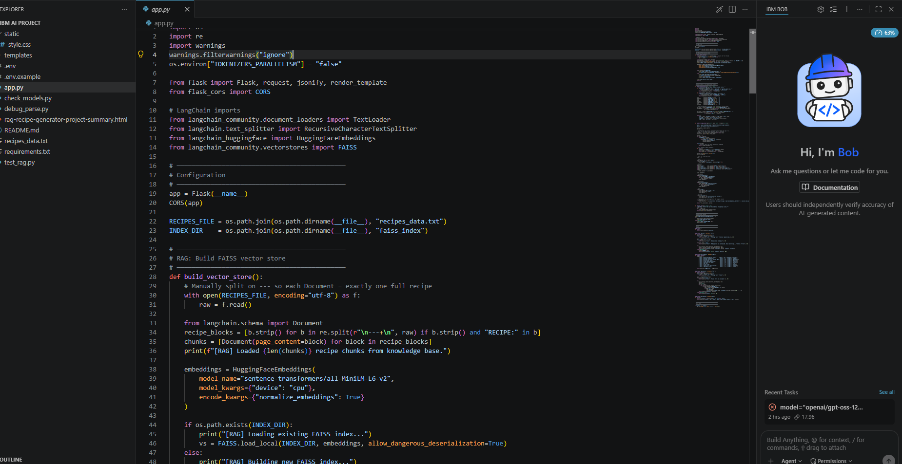
Required Files created using IBM bob -
App.py
Requirements.txt
Style.css
.env
Index.html

Slide 7
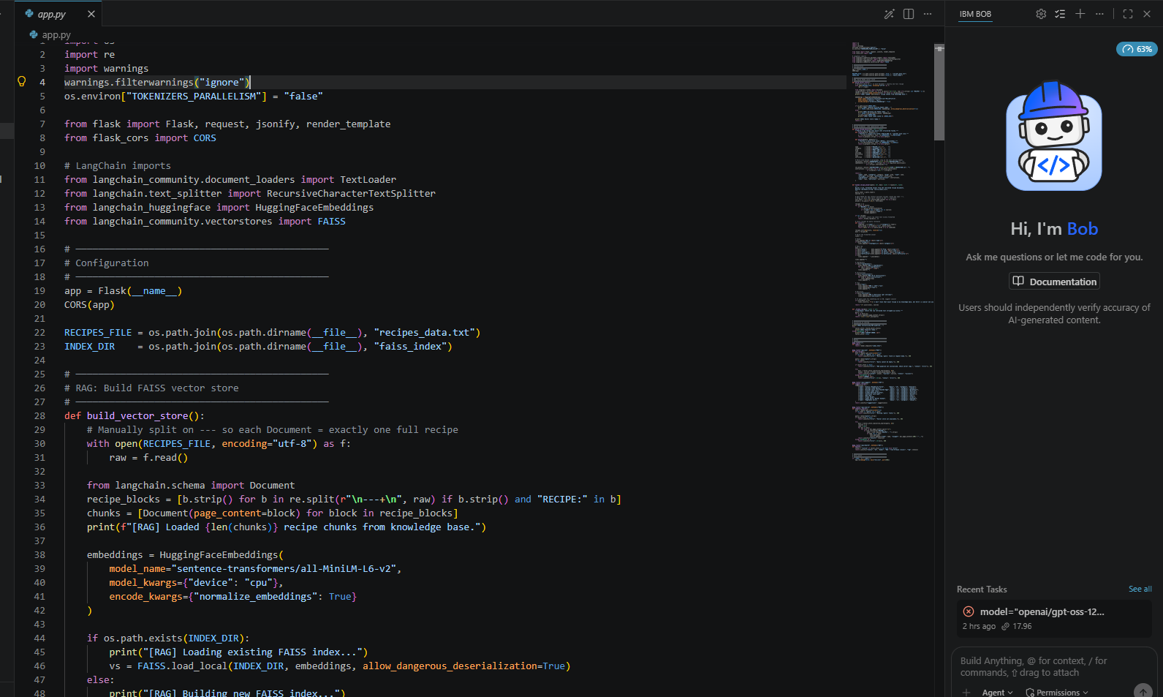
IBM Bob Screenshots:

Slide 8
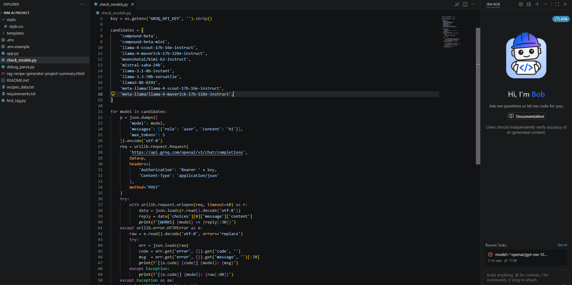

Slide 9

Role of Agentic AI in the solution
Role of Agentic AI in Recipe Generator
Agentic AI enables the Nutrition Agent to function as an intelligent, autonomous system rather than a simple chatbot. Using IBM watsonx.ai and IBM Granite models, it coordinates multiple specialized agents to deliver personalized nutrition guidance.
Each agent performs a specific role—such as retrieving nutritional data, generating diet plans, providing health advice, and analyzing food logs—while working collaboratively. This multi-agent approach ensures efficient task execution and accurate results.
Agentic AI also brings context awareness, understanding user details like age, health conditions, and fitness goals to generate tailored recommendations. It supports real-time adaptation, continuously updating suggestions based on user inputs like daily meals.
Additionally, agents communicate with each other, enabling better decision-making and improved outcomes.
Overall, Agentic AI makes the system proactive, personalized, and goal-driven, acting like a smart digital nutritionist that helps users maintain a healthy lifestyle.

Slide 10
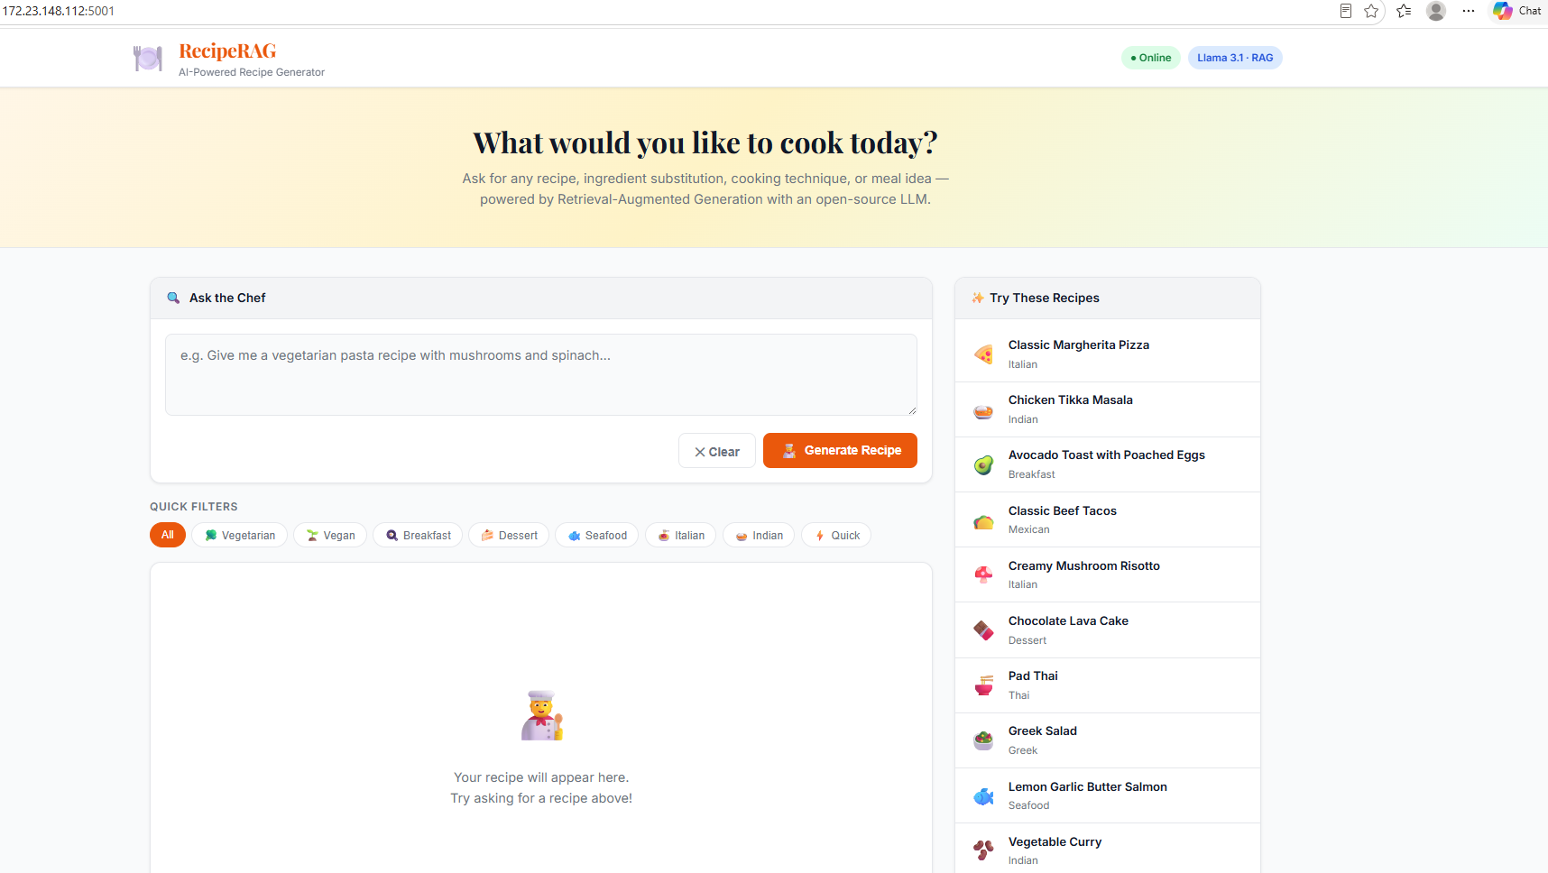
Project Output Screenshot
·
·
·

Slide 11
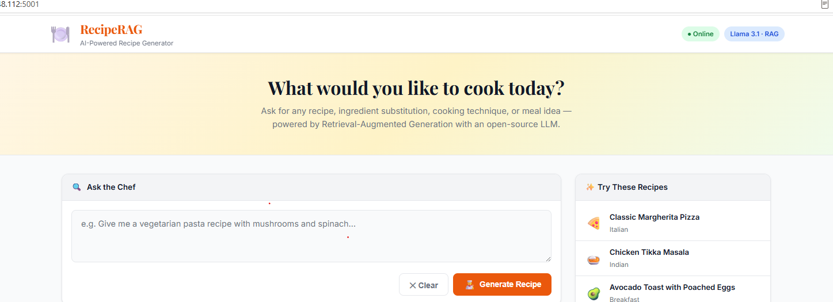
Project Output Screenshot
·
·
·

Slide 12
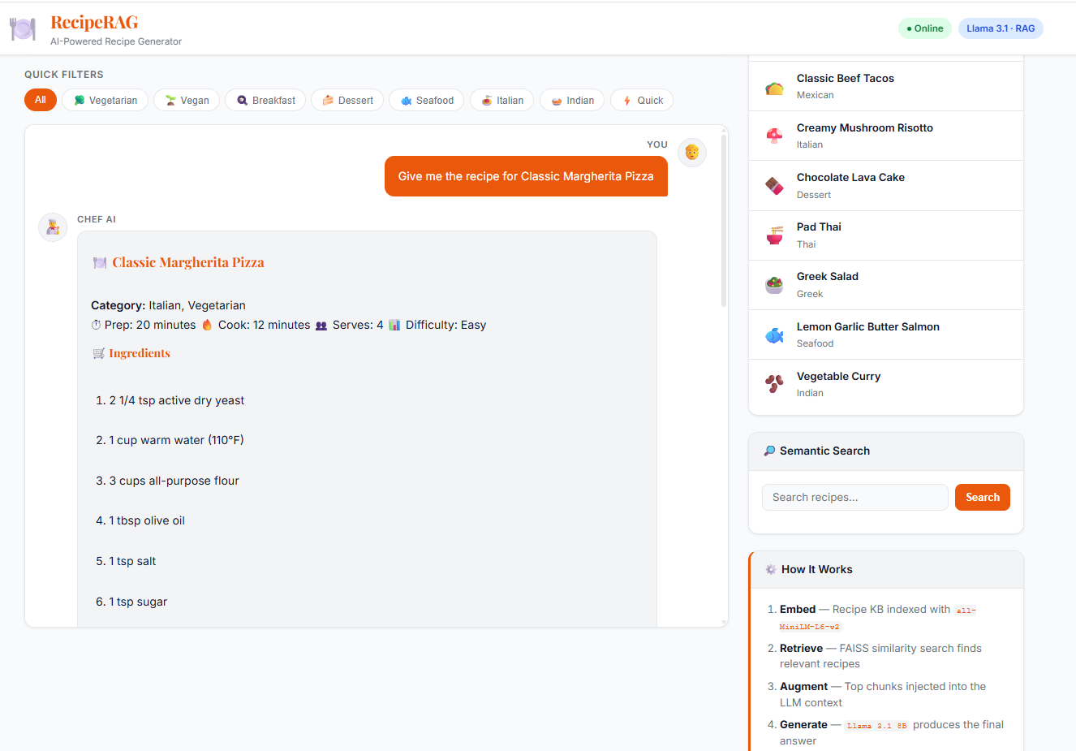
Project Output Screenshot

Slide 13
Novelty and Uniqueness
The proposed Nutrition Agent stands out by combining Agentic AI, RAG, and personalization into a single intelligent system.
Multi-Agent Intelligence – Instead of a single chatbot, multiple specialized agents collaborate to deliver accurate and context-aware nutrition guidance.
RAG-Based Accuracy – Integrates real-time data retrieval with AI generation, reducing misinformation and ensuring trustworthy recommendations.
Hyper-Personalization – Tailors diet plans based on health conditions, cultural preferences, and fitness goals.
Real-Time Feedback Loop – Continuously adapts recommendations based on daily food logs and user behavior.
Multi-Modal Input – Supports text, voice, and image-based meal tracking for better usability.
Preventive Healthcare Focus – Goes beyond diet planning to provide disease-specific nutrition advice.
Scalable & Enterprise-Ready – Built on IBM watsonx.ai with IBM Granite models, ensuring reliability and governance.
This makes the solution a smart, adaptive, and proactive digital nutritionist, not just a static diet recommendation tool.

Slide 14
Git Hub Link

Slide 15
Future Scope
Personalized recipe recommendations based on user preferences and dietary needs.
Voice-based interaction for hands-free cooking assistance.
Nutrition information such as calories, protein, carbohydrates, etc.
Ingredient-based recipe generation using ingredients available at home.
Multilingual support for users in different languages.
Mobile application for easier access.
Integration with shopping lists and grocery platforms for required ingredients.
·

Slide 16
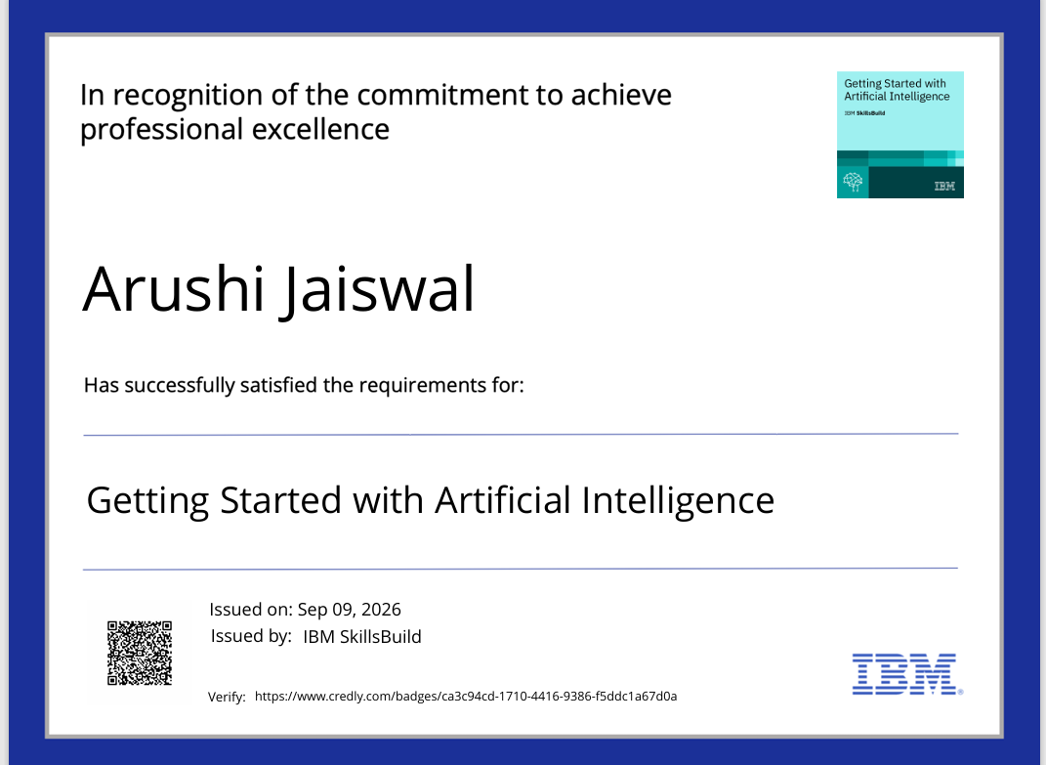
Certificates Earned:
Please add your credly certificate(Getting Started with Artificial Intelligence)

Slide 17
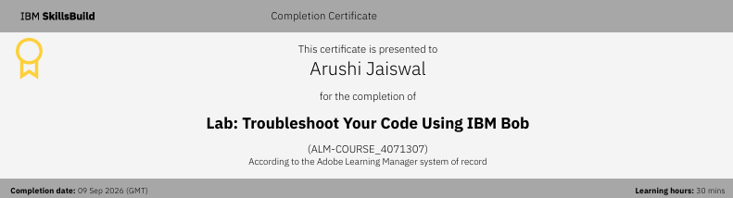
Certificates Earned:​
Add your IBM BOB Certificate

Slide 18


